Slide 1
18-799: Applied Computer Vision Spring 2026
Image Formation

Slide 2
Objectives
In today’s class we will learn
Homogeneous Coordinates and transformation
Geometric primitive
Geometric Image formation
Photometric image formation

Slide 3
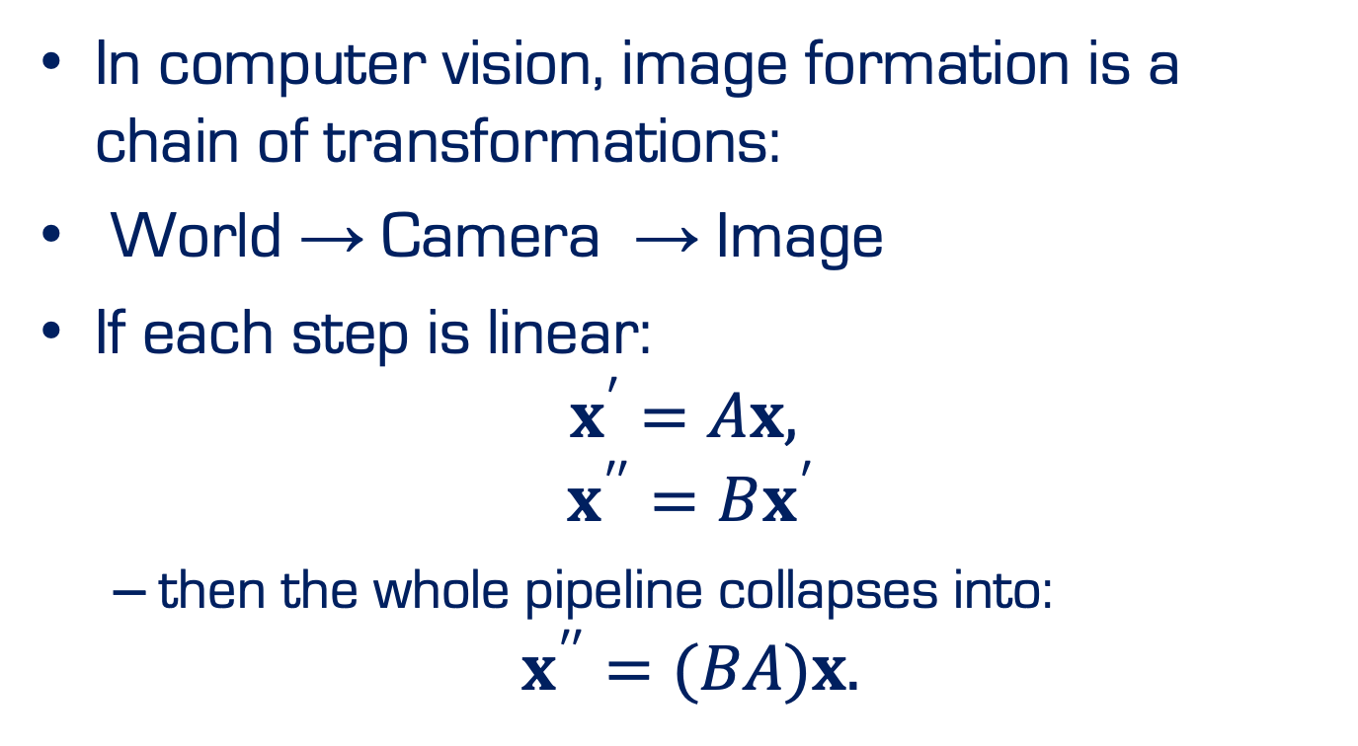
Homogeneous Coordinates
In computer vision, image formation is a chain of transformations:
$\text{World}\text{ → }\text{Camera} \text{→ }\text{Image}$
If each step is linear:
$$x^{′}=Ax,$$
$$x^{′′}=Bx^{′}$$
then the whole pipeline collapses into:
$$x^{′′}=(BA)x.$$

Slide 4
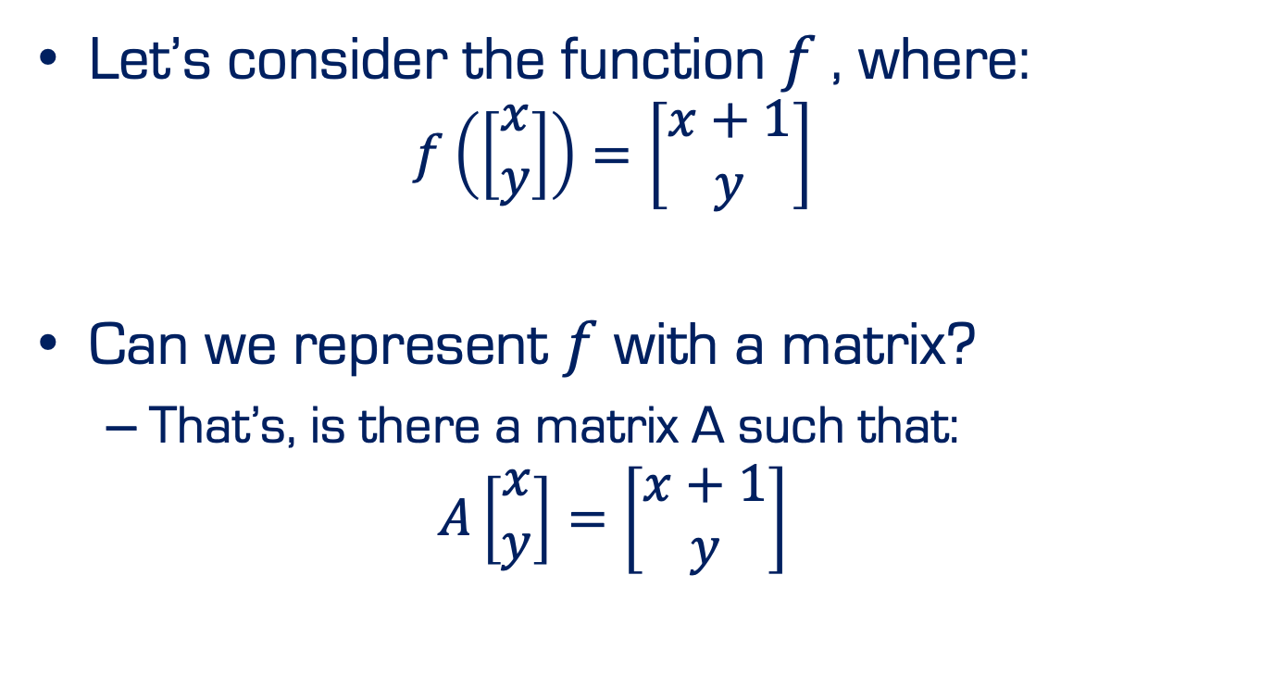
Homogeneous Coordinates
Let’s consider the function $f$, where:
$$f\left(\left[\begin{matrix}x \\ y\end{matrix}\right]\right)=\left[\begin{matrix}x+1 \\ y\end{matrix}\right]$$
Can we represent $f$ with a matrix?
That’s, is there a matrix A such that:
$$A\left[\begin{matrix}x \\ y\end{matrix}\right]=\left[\begin{matrix}x+1 \\ y\end{matrix}\right]$$

Slide 5
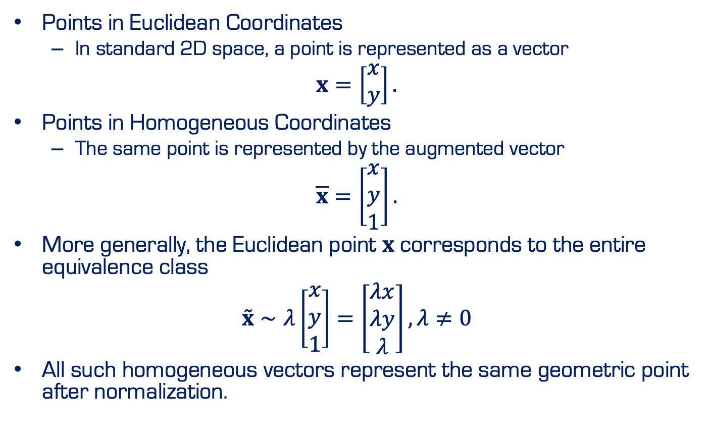
Homogeneous Coordinates
Points in Euclidean Coordinates
In standard 2D space, a point is represented as a vector
$$x=\left[\begin{matrix}x \\ y\end{matrix}\right].$$
Points in Homogeneous Coordinates
The same point is represented by the augmented vector
$$\overline{x}=\left[\begin{matrix}x \\ y \\ 1\end{matrix}\right].$$
More generally, the Euclidean point $x$ corresponds to the entire equivalence class
$$\overset{˜}{x}∼λ\left[\begin{matrix}x \\ y \\ 1\end{matrix}\right]=\left[\begin{matrix}λx \\ λy \\ λ\end{matrix}\right], λ≠0$$
All such homogeneous vectors represent the same geometric point after normalization.

Slide 6
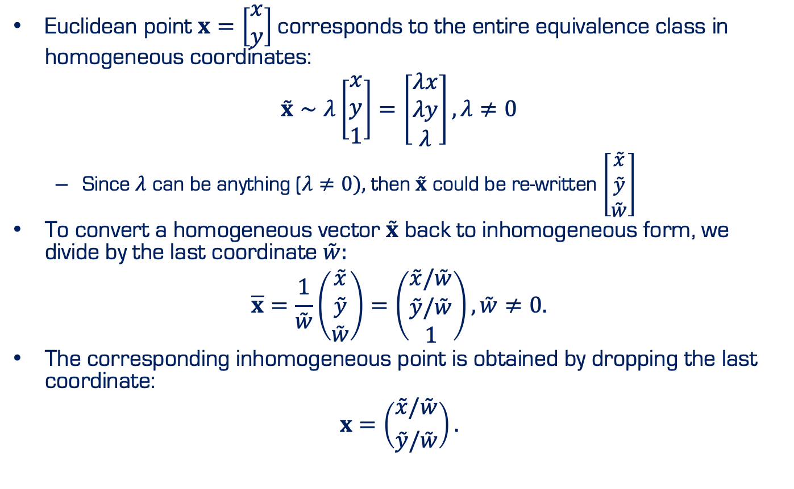
Homogeneous Coordinates
Euclidean point $x=\left[\begin{matrix}x \\ y\end{matrix}\right]$corresponds to the entire equivalence class in homogeneous coordinates:
$$\overset{˜}{x}∼λ\left[\begin{matrix}x \\ y \\ 1\end{matrix}\right]=\left[\begin{matrix}λx \\ λy \\ λ\end{matrix}\right], λ≠0$$
Since $λ$ can be anything ($λ≠0),$then $\overset{˜}{x}$ could be re-written $\left[\begin{matrix}\overset{˜}{x} \\ \overset{˜}{y} \\ \overset{˜}{w}\end{matrix}\right]$
To convert a homogeneous vector $\overset{˜}{x}$ back to inhomogeneous form, we divide by the last coordinate $\overset{˜}{w}:$
$$\overline{x}=\frac{1}{\overset{˜}{w}}\left(\begin{matrix}\overset{˜}{x} \\ \overset{˜}{y} \\ \overset{˜}{w}\end{matrix}\right)=\left(\begin{matrix}\overset{˜}{x}/\overset{˜}{w} \\ \overset{˜}{y}/\overset{˜}{w} \\ 1\end{matrix}\right), \overset{˜}{w}≠0.$$
The corresponding inhomogeneous point is obtained by dropping the last coordinate:
$$x=\left({\overset{˜}{x}/\overset{˜}{w} \atop \overset{˜}{y}/\overset{˜}{w}}\right).$$

Slide 7
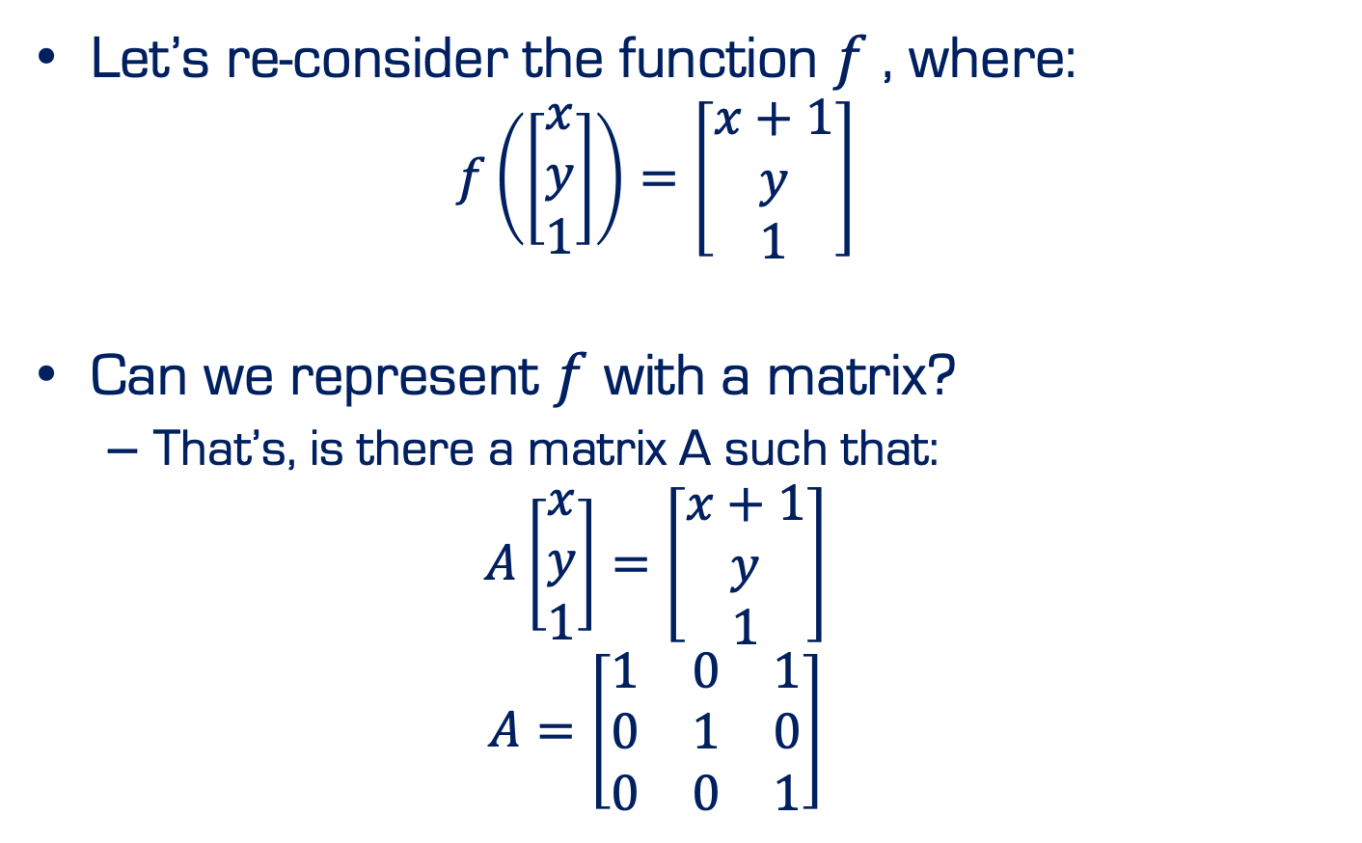
Homogeneous Coordinates
Let’s re-consider the function $f$, where:
$$f\left(\left[\begin{aligned}\begin{matrix}x \\ y\end{matrix} \\ 1\end{aligned}\right]\right)=\left[\begin{aligned}\begin{matrix}x+1 \\ y\end{matrix} \\ 1\end{aligned}\right]$$
Can we represent $f$ with a matrix?
That’s, is there a matrix A such that:
$$A\left[\begin{aligned}\begin{matrix}x \\ y\end{matrix} \\ 1\end{aligned}\right]=\left[\begin{aligned}\begin{matrix}x+1 \\ y\end{matrix} \\ 1\end{aligned}\right]$$
$$A=\left[\begin{matrix}1 & 0 & 1 \\ 0 & 1 & 0 \\ 0 & 0 & 1\end{matrix}\right]$$

Slide 8
Geometric primitive
Geometric primitives are the basic building blocks used to describe 3D shapes
Examples: Points, lines, planes

Slide 9
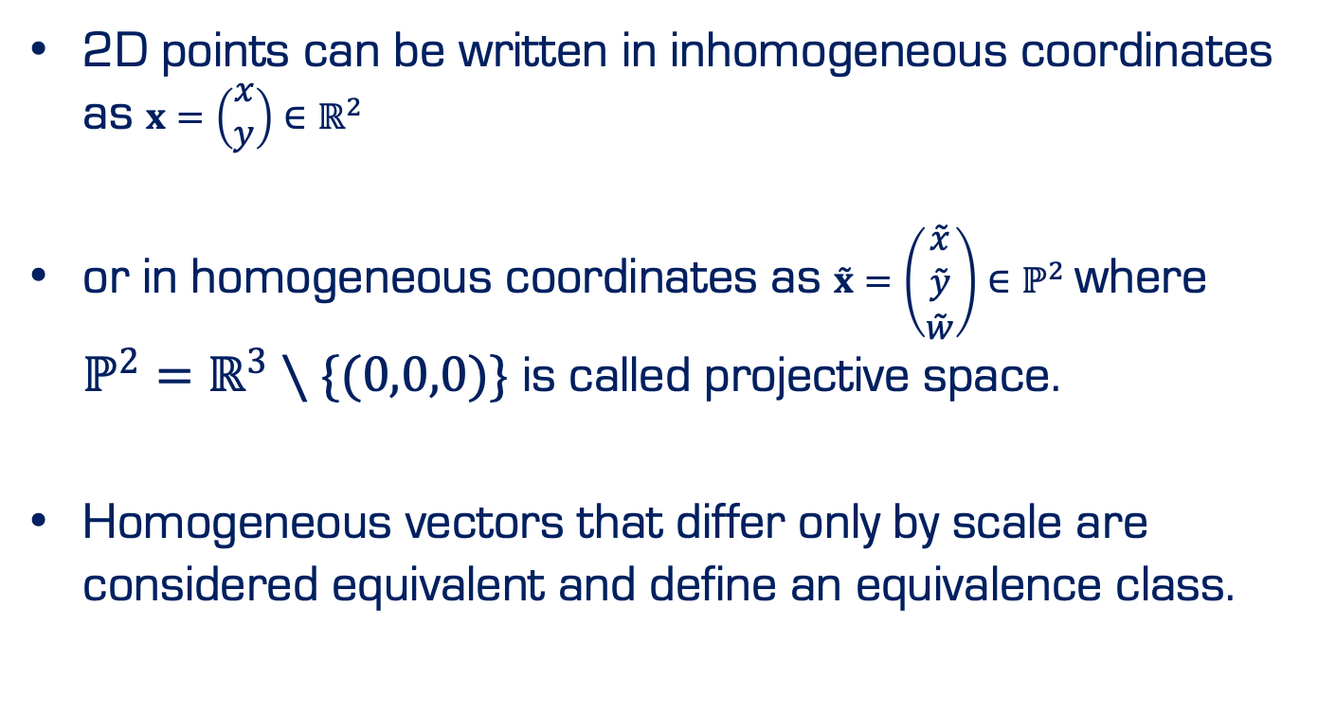
2D Points
2D points can be written in inhomogeneous coordinates as $x=\left(\begin{matrix}x \\ y\end{matrix}\right)∈ℝ^{2}$
or in homogeneous coordinates as $\overset{˜}{x}=\left(\begin{matrix}\overset{˜}{x} \\ \overset{˜}{y} \\ \overset{˜}{w}\end{matrix}\right)∈ℙ^{2}$ where $ℙ^{2}=ℝ^{3}∖\{(0,0,0)\}$ is called projective space.
Homogeneous vectors that differ only by scale are considered equivalent and define an equivalence class.

Slide 10
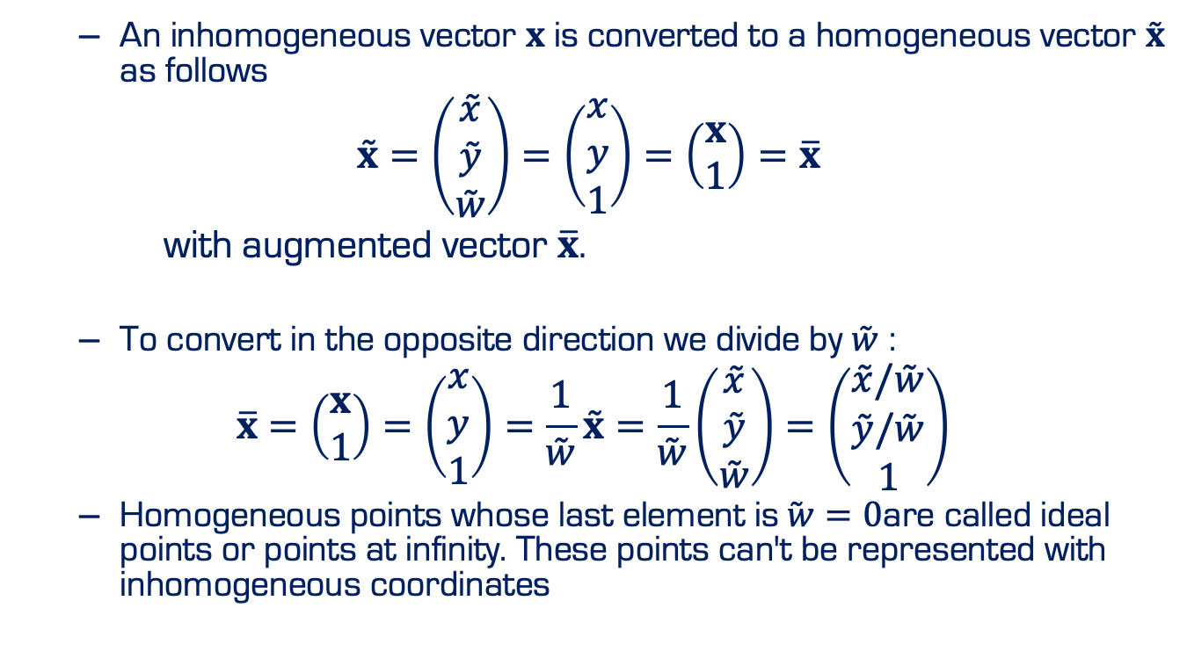
2D Points
An inhomogeneous vector $x$ is converted to a homogeneous vector $\overset{˜}{x}$ as follows
$$\overset{˜}{x}=\left(\begin{matrix}\overset{˜}{x} \\ \overset{˜}{y} \\ \overset{˜}{w}\end{matrix}\right)=\left(\begin{matrix}x \\ y \\ 1\end{matrix}\right)=\left(\begin{matrix}x \\ 1\end{matrix}\right)=\overline{x}$$
with augmented vector $\overline{x}$.
To convert in the opposite direction we divide by $\overset{˜}{w}$ :
$$\overline{x}=\left(\begin{matrix}x \\ 1\end{matrix}\right)=\left(\begin{matrix}x \\ y \\ 1\end{matrix}\right)=\frac{1}{\overset{˜}{w}}\overset{˜}{x}=\frac{1}{\overset{˜}{w}}\left(\begin{matrix}\overset{˜}{x} \\ \overset{˜}{y} \\ \overset{˜}{w}\end{matrix}\right)=\left(\begin{matrix}\overset{˜}{x}/\overset{˜}{w} \\ \overset{˜}{y}/\overset{˜}{w} \\ 1\end{matrix}\right)$$
Homogeneous points whose last element is$\overset{˜}{ w}=0$are called ideal points or points at infinity. These points can't be represented with inhomogeneous coordinates

Slide 11
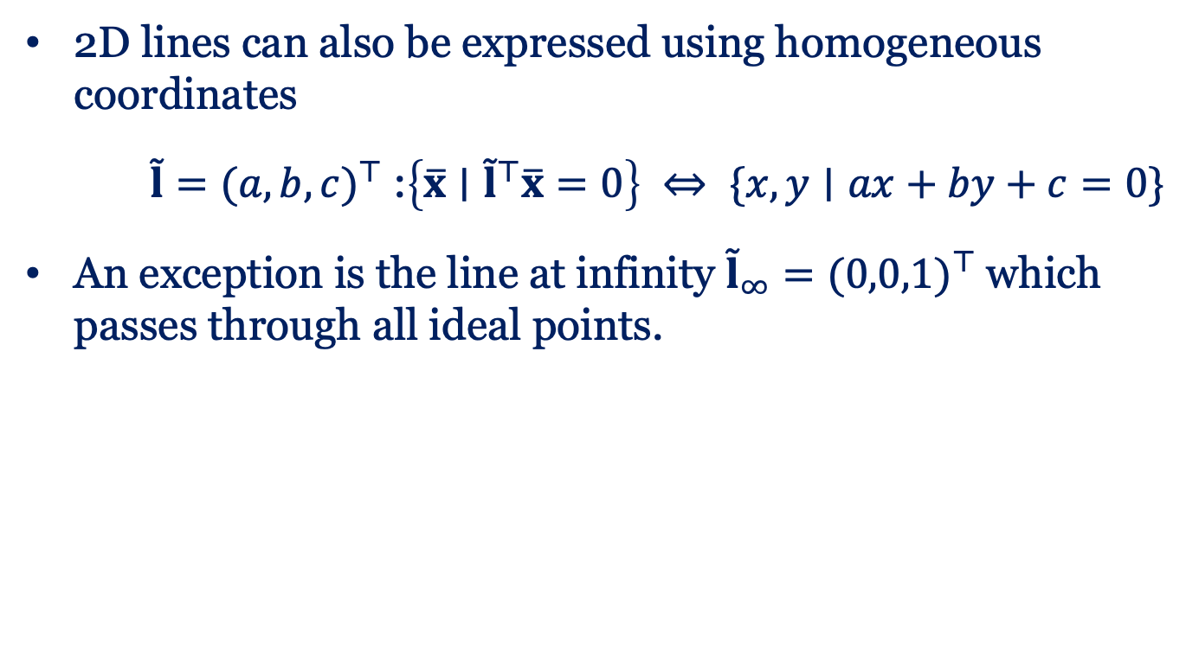
2D Lines
2D lines can also be expressed using homogeneous coordinates
$\overset{˜}{l}=(a,b,c)^{⊤}$ :$\left\{\overline{x}∣{\overset{˜}{l}}^{⊤}\overline{x}=0\right\} ⇔ \{x,y∣ax+by+c=0\}$
An exception is the line at infinity ${\overset{˜}{l}}_{∞}=(0,0,1)^{⊤}$ which passes through all ideal points.

Slide 12
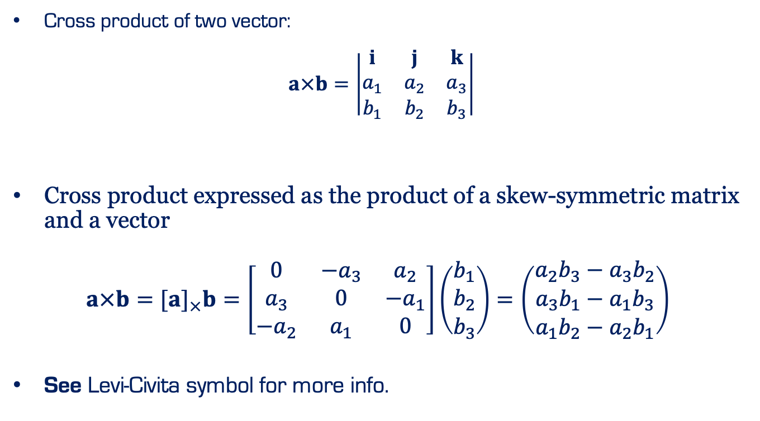
Cross Product
Cross product of two vector:
$$a×b=\left|\begin{matrix}i & j & k \\ a_{1} & a_{2} & a_{3} \\ b_{1} & b_{2} & b_{3}\end{matrix}\right|$$
Cross product expressed as the product of a skew-symmetric matrix and a vector
$a×b=[a]_{×}b=\left[\begin{matrix}0 & −a_{3} & a_{2} \\ a_{3} & 0 & −a_{1} \\ −a_{2} & a_{1} & 0\end{matrix}\right]\left(\begin{matrix}b_{1} \\ b_{2} \\ b_{3}\end{matrix}\right)=\left(\begin{matrix}a_{2}b_{3}−a_{3}b_{2} \\ a_{3}b_{1}−a_{1}b_{3} \\ a_{1}b_{2}−a_{2}b_{1}\end{matrix}\right)$
See Levi-Civita symbol for more info.

Slide 13
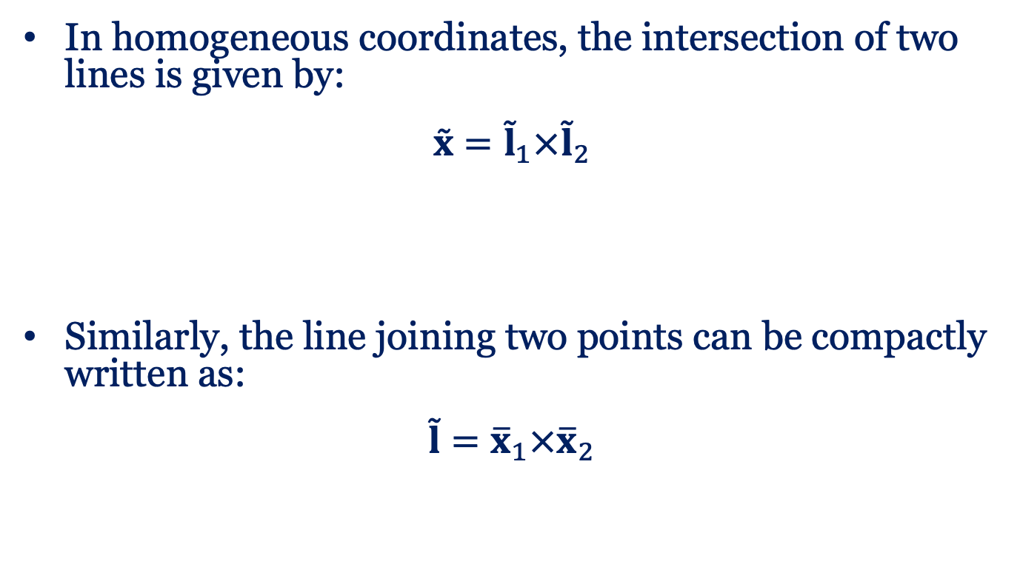
Cross Product
In homogeneous coordinates, the intersection of two lines is given by:
$$\overset{˜}{x}={\overset{˜}{l}}_{1}×{\overset{˜}{l}}_{2}$$
Similarly, the line joining two points can be compactly written as:
$$\overset{˜}{l}={\overline{x}}_{1}×{\overline{x}}_{2}$$

Slide 14
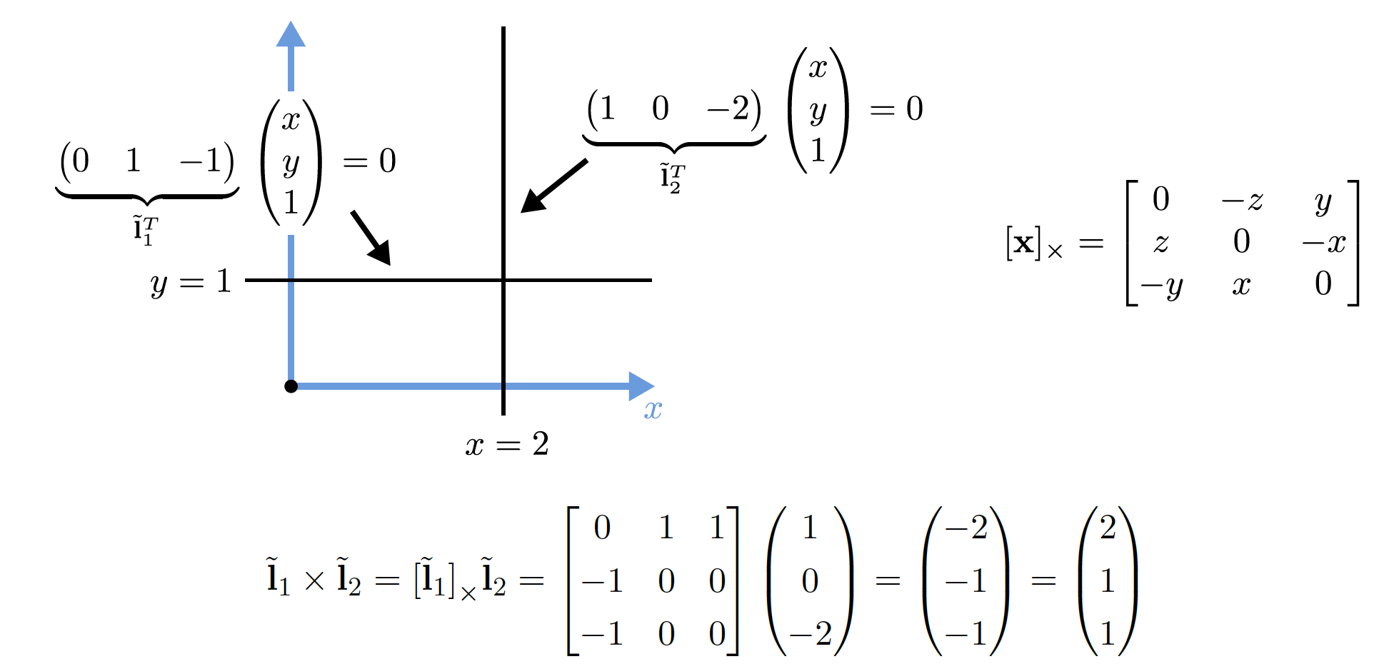
2D Line: Example

Slide 15
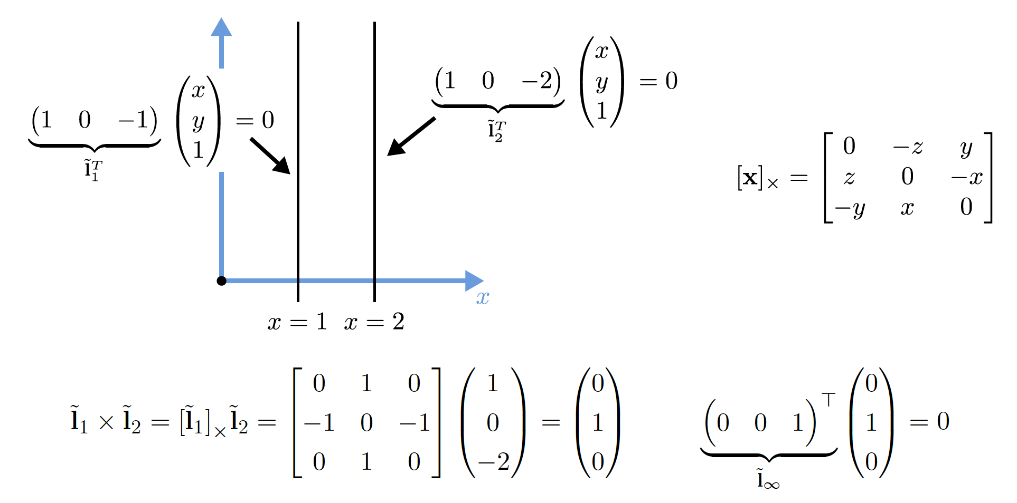
2D Line: Example

Slide 16
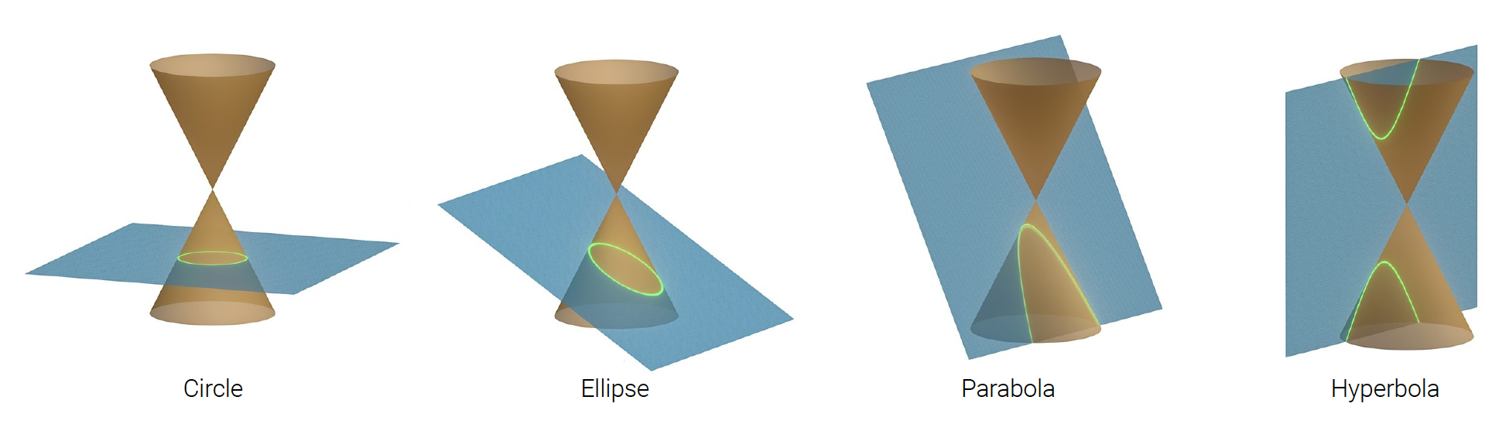
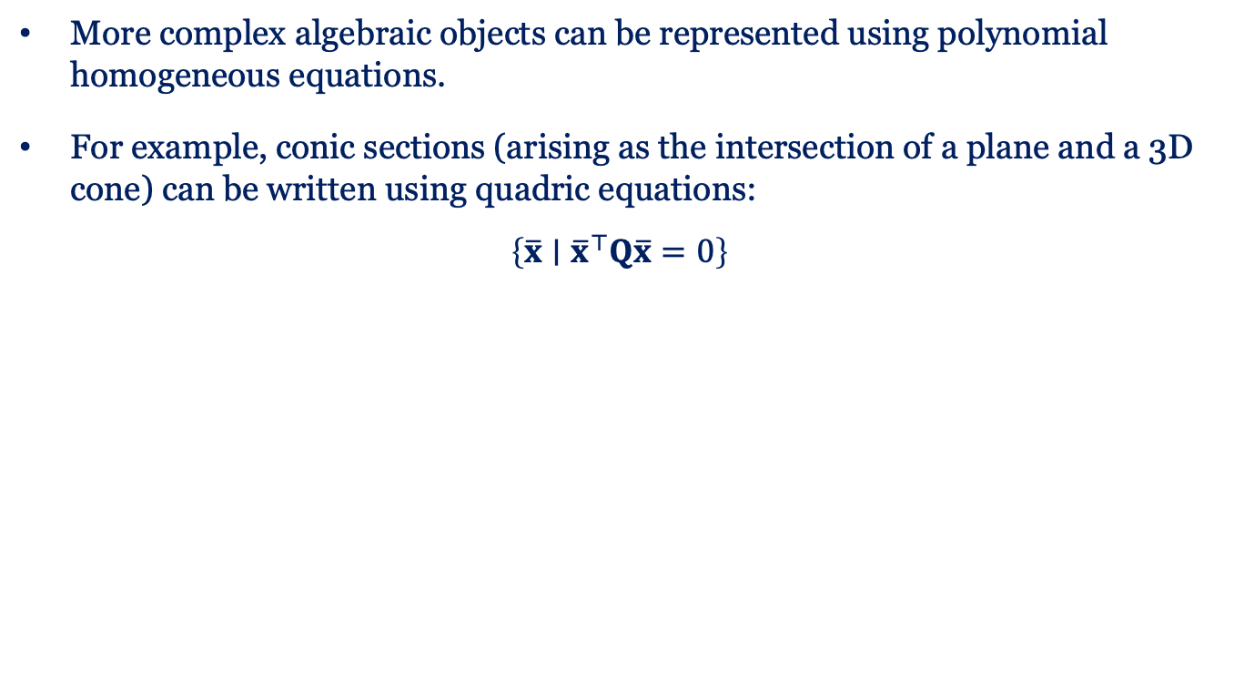
2D Conics
More complex algebraic objects can be represented using polynomial homogeneous equations.
For example, conic sections (arising as the intersection of a plane and a 3D cone) can be written using quadric equations:
$$\left\{\overline{x}∣{\overline{x}}^{⊤}Q\overline{x}=0\right\}$$

Slide 17
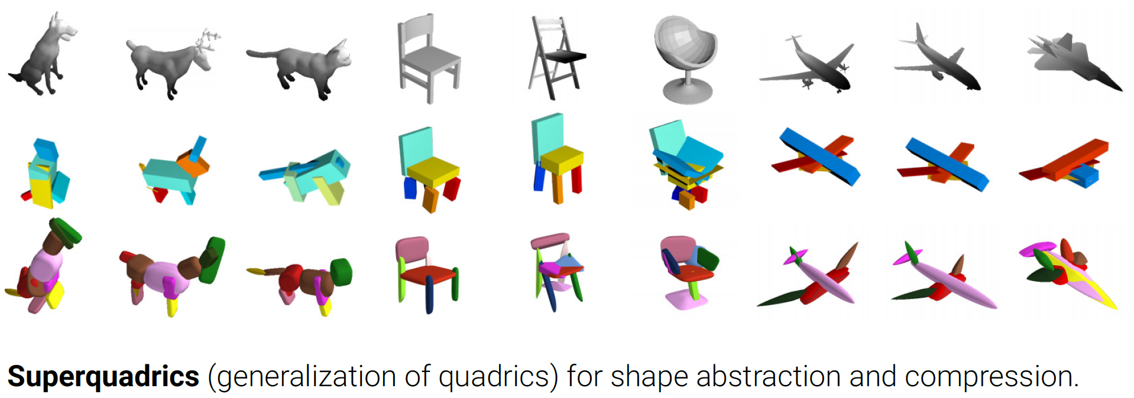

3D Quadrics
The 3D analog of 2D conics is a quadric surface:
$$\left\{\overline{x}∣{\overline{x}}^{⊤}Q\overline{x}=0\right\}$$
Paschalidou, Ulusoy and Geiger: Superquadrics Revisited: Learning 3D Shape Parsing beyond Cuboids. CVPR, 2019

Slide 18
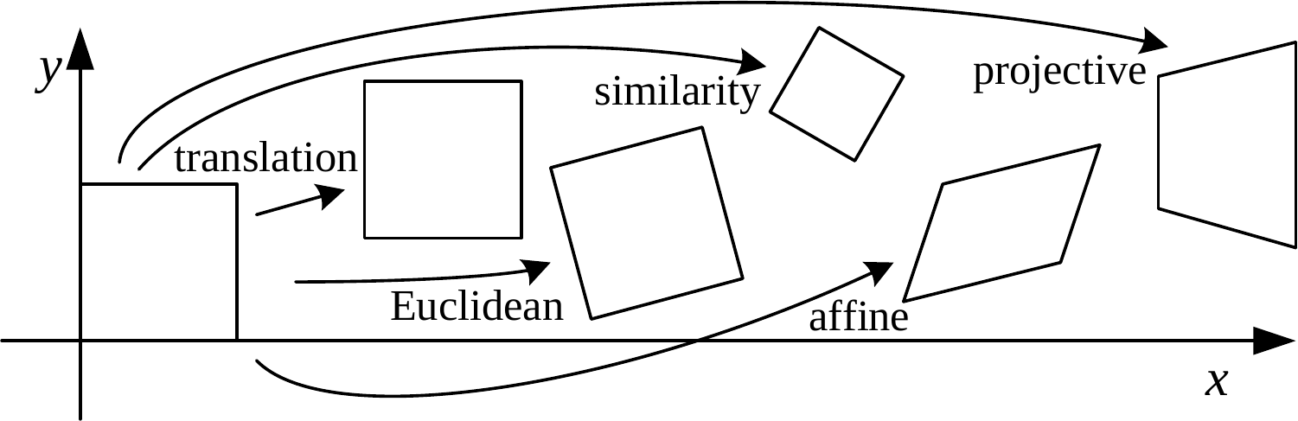
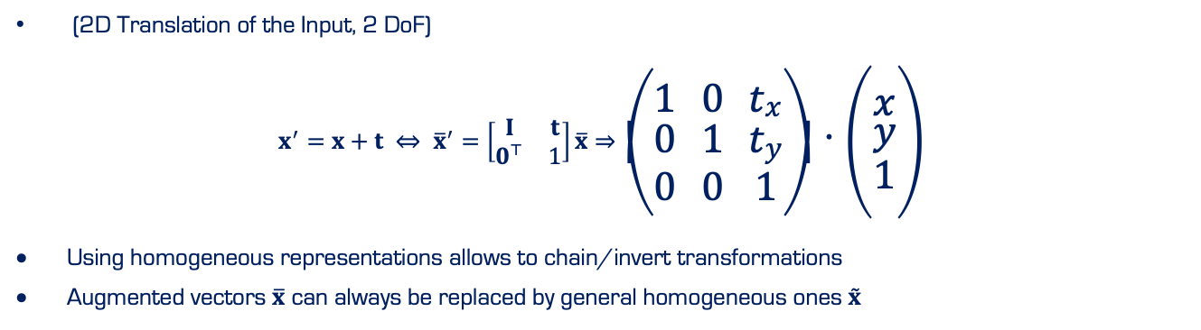
Translation
(2D Translation of the Input, 2 DoF)
$$x^{′}=x+t ⇔ {\overline{x}}^{′}=\left[\begin{matrix}I & t \\ 0^{⊤} & 1\end{matrix}\right]\overline{x}⇒\left(\begin{matrix}1 & 0 & t_{x} \\ 0 & 1 & t_{y} \\ 0 & 0 & 1\end{matrix}\right)⋅\left(\begin{matrix}x \\ y \\ 1\end{matrix}\right)$$
Using homogeneous representations allows to chain/invert transformations
Augmented vectors $\overline{x}$ can always be replaced by general homogeneous ones $\overset{˜}{x}$

Slide 19
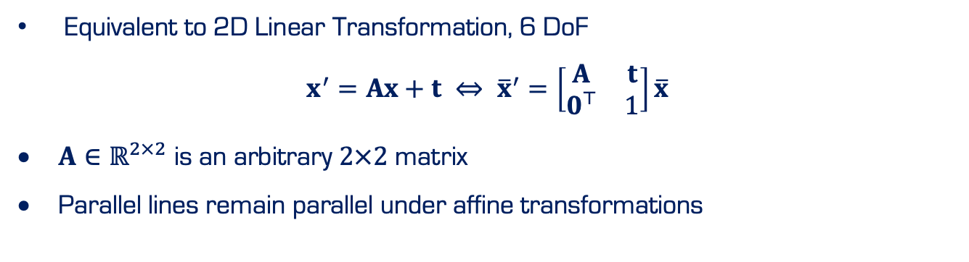
Affine
Equivalent to 2D Linear Transformation, 6 DoF
$$x^{′}=Ax+t ⇔ {\overline{x}}^{′}=\left[\begin{matrix}A & t \\ 0^{⊤} & 1\end{matrix}\right]\overline{x}$$
$A∈ℝ^{2×2}$ is an arbitrary $2×2$ matrix
Parallel lines remain parallel under affine transformations

Slide 20
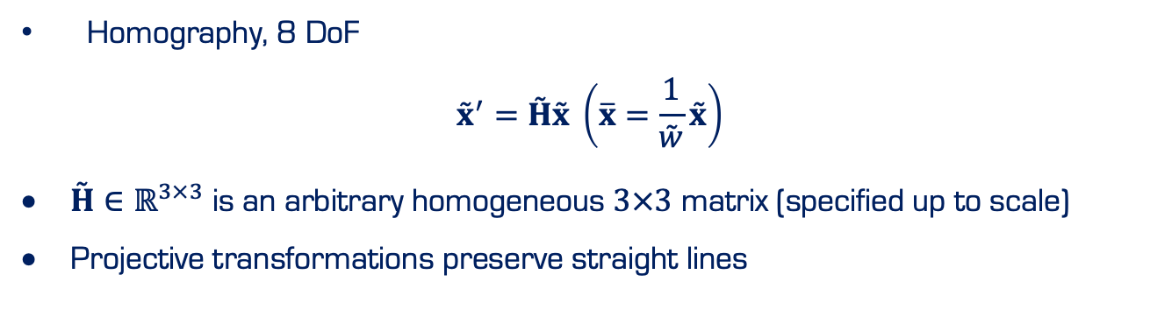
Projective
Homography, 8 DoF
$${\overset{˜}{x}}^{′}=\overset{˜}{H}\overset{˜}{x} \left(\overline{x}=\frac{1}{\overset{˜}{w}}\overset{˜}{x}\right)$$
$\overset{˜}{H}∈ℝ^{3×3}$ is an arbitrary homogeneous $3×3$ matrix (specified up to scale)
Projective transformations preserve straight lines
Notes:
Sia

Slide 21
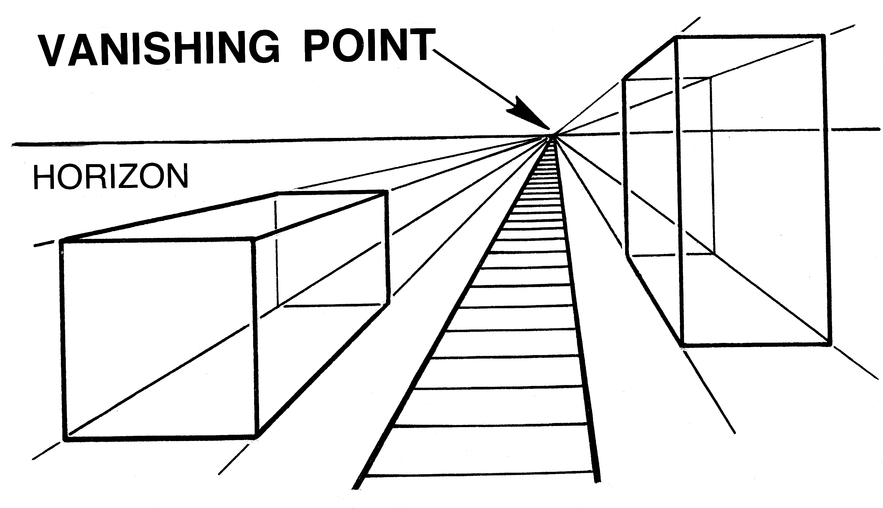
Projective
©commons.wikimedia.org
Notes:
Sia

Slide 22
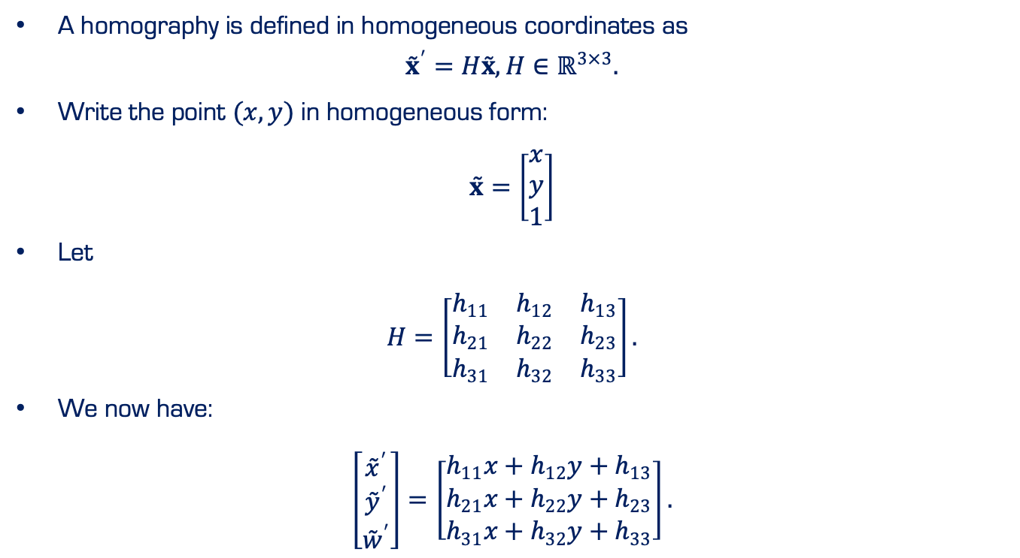
Projective
A homography is defined in homogeneous coordinates as
$${\overset{˜}{x}}^{′}=H\overset{˜}{x}, H∈ℝ^{3×3}.$$
Write the point $(x,y)$ in homogeneous form:
$$\overset{˜}{x}=\left[\begin{matrix}x \\ y \\ 1\end{matrix}\right]$$
Let
$$H=\left[\begin{matrix}h_{11} & h_{12} & h_{13} \\ h_{21} & h_{22} & h_{23} \\ h_{31} & h_{32} & h_{33}\end{matrix}\right].$$
We now have:
$$\left[\begin{matrix}{\overset{˜}{x}}^{′} \\ {\overset{˜}{y}}^{′} \\ {\overset{˜}{w}}^{′}\end{matrix}\right]=\left[\begin{matrix}h_{11}x+h_{12}y+h_{13} \\ h_{21}x+h_{22}y+h_{23} \\ h_{31}x+h_{32}y+h_{33}\end{matrix}\right].$$
Notes:
Sia

Slide 23
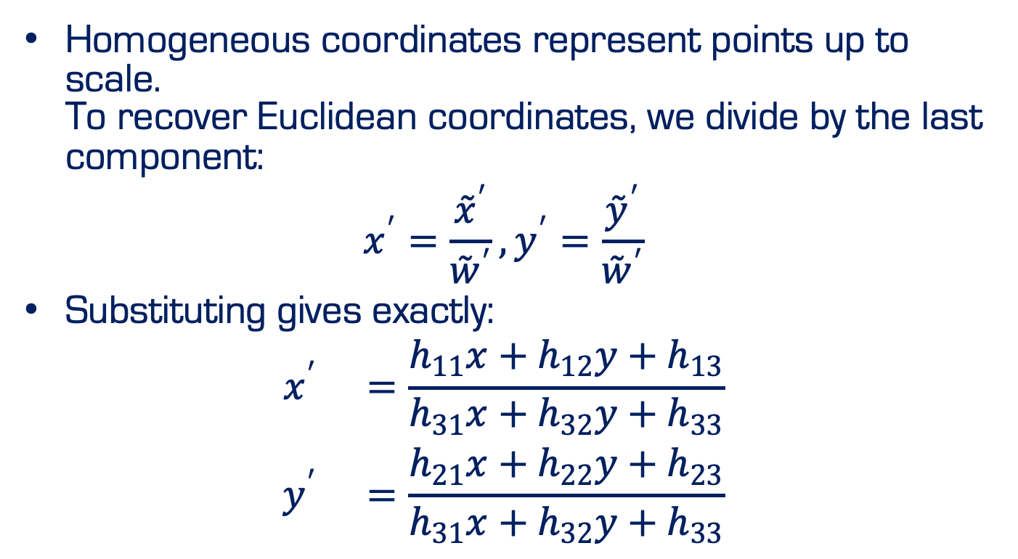
Projective
Homogeneous coordinates represent points up to scale. To recover Euclidean coordinates, we divide by the last component:
$$x^{′}=\frac{{\overset{˜}{x}}^{′}}{{\overset{˜}{w}}^{′}}, y^{′}=\frac{{\overset{˜}{y}}^{′}}{{\overset{˜}{w}}^{′}}$$
Substituting gives exactly:
$$\begin{matrix}x^{′} & =\frac{h_{11}x+h_{12}y+h_{13}}{h_{31}x+h_{32}y+h_{33}} \\ y^{′} & =\frac{h_{21}x+h_{22}y+h_{23}}{h_{31}x+h_{32}y+h_{33}}\end{matrix}$$
Notes:
Sia

Slide 24
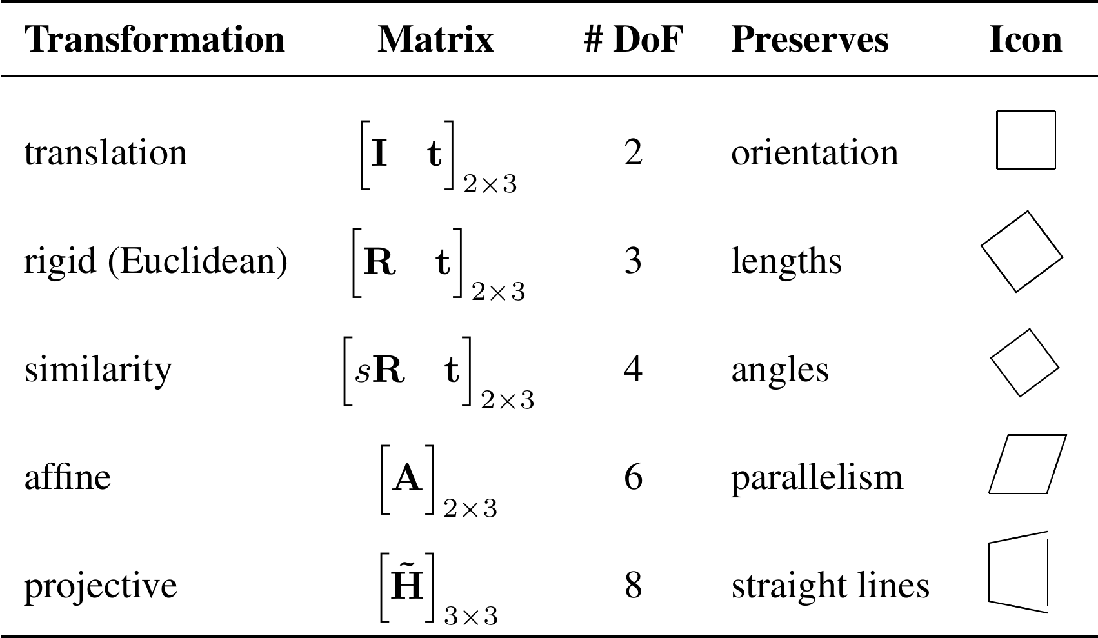
2D Transformation

Slide 25
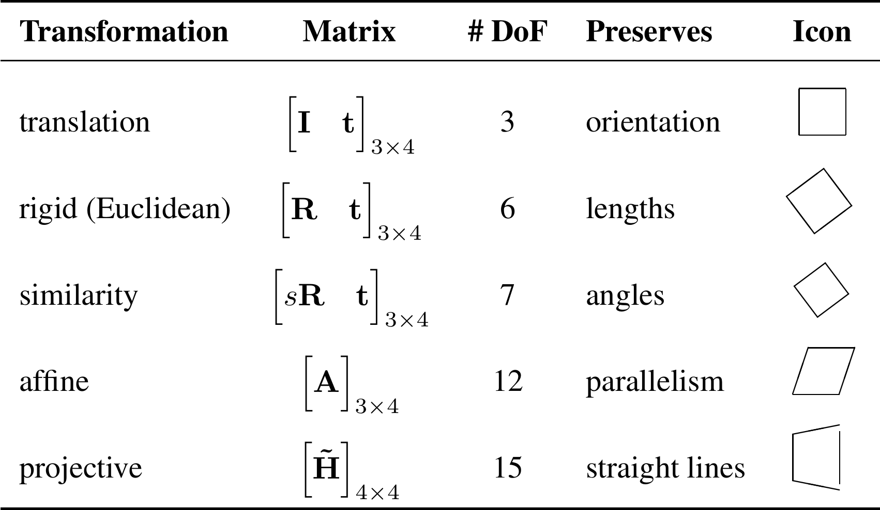
3D Transformation

Slide 26

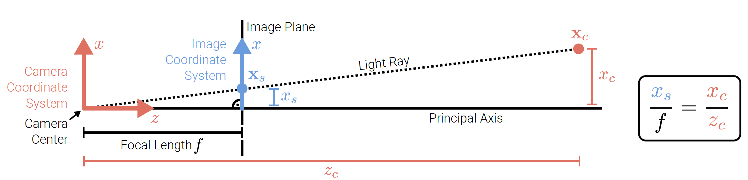
Geometric Image Formation

Slide 27
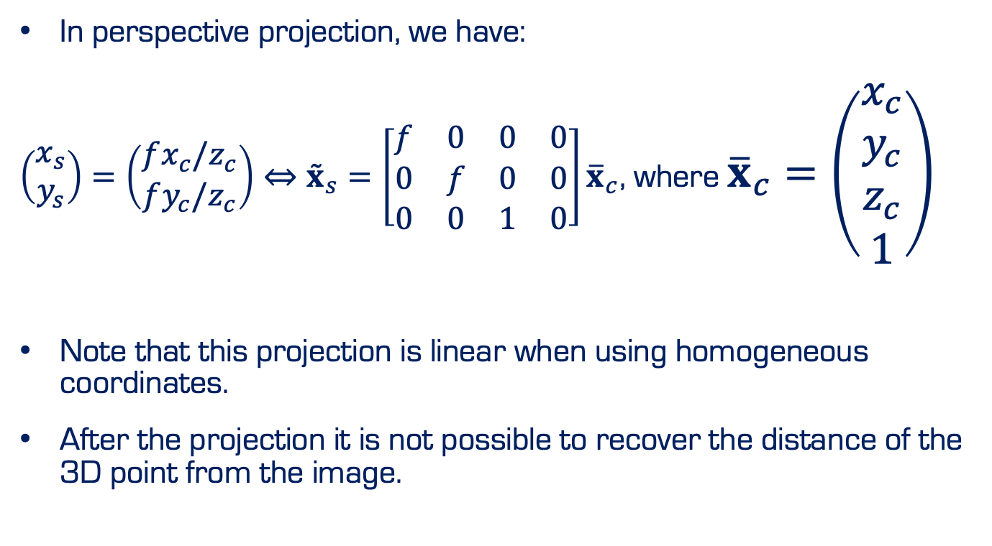
Perspective Projection
In perspective projection, we have:
$\left(\begin{matrix}x_{s} \\ y_{s}\end{matrix}\right)=\left(\begin{matrix}fx_{c}/z_{c} \\ fy_{c}/z_{c}\end{matrix}\right)⇔{\overset{˜}{x}}_{s}=\left[\begin{matrix}f & 0 & 0 & 0 \\ 0 & f & 0 & 0 \\ 0 & 0 & 1 & 0\end{matrix}\right]{\overline{x}}_{c}$, where ${\overline{x}}_{c}=\left(\begin{matrix}x_{c} \\ y_{c} \\ z_{c} \\ 1\end{matrix}\right)$
Note that this projection is linear when using homogeneous coordinates.
After the projection it is not possible to recover the distance of the 3D point from the image.

Slide 28
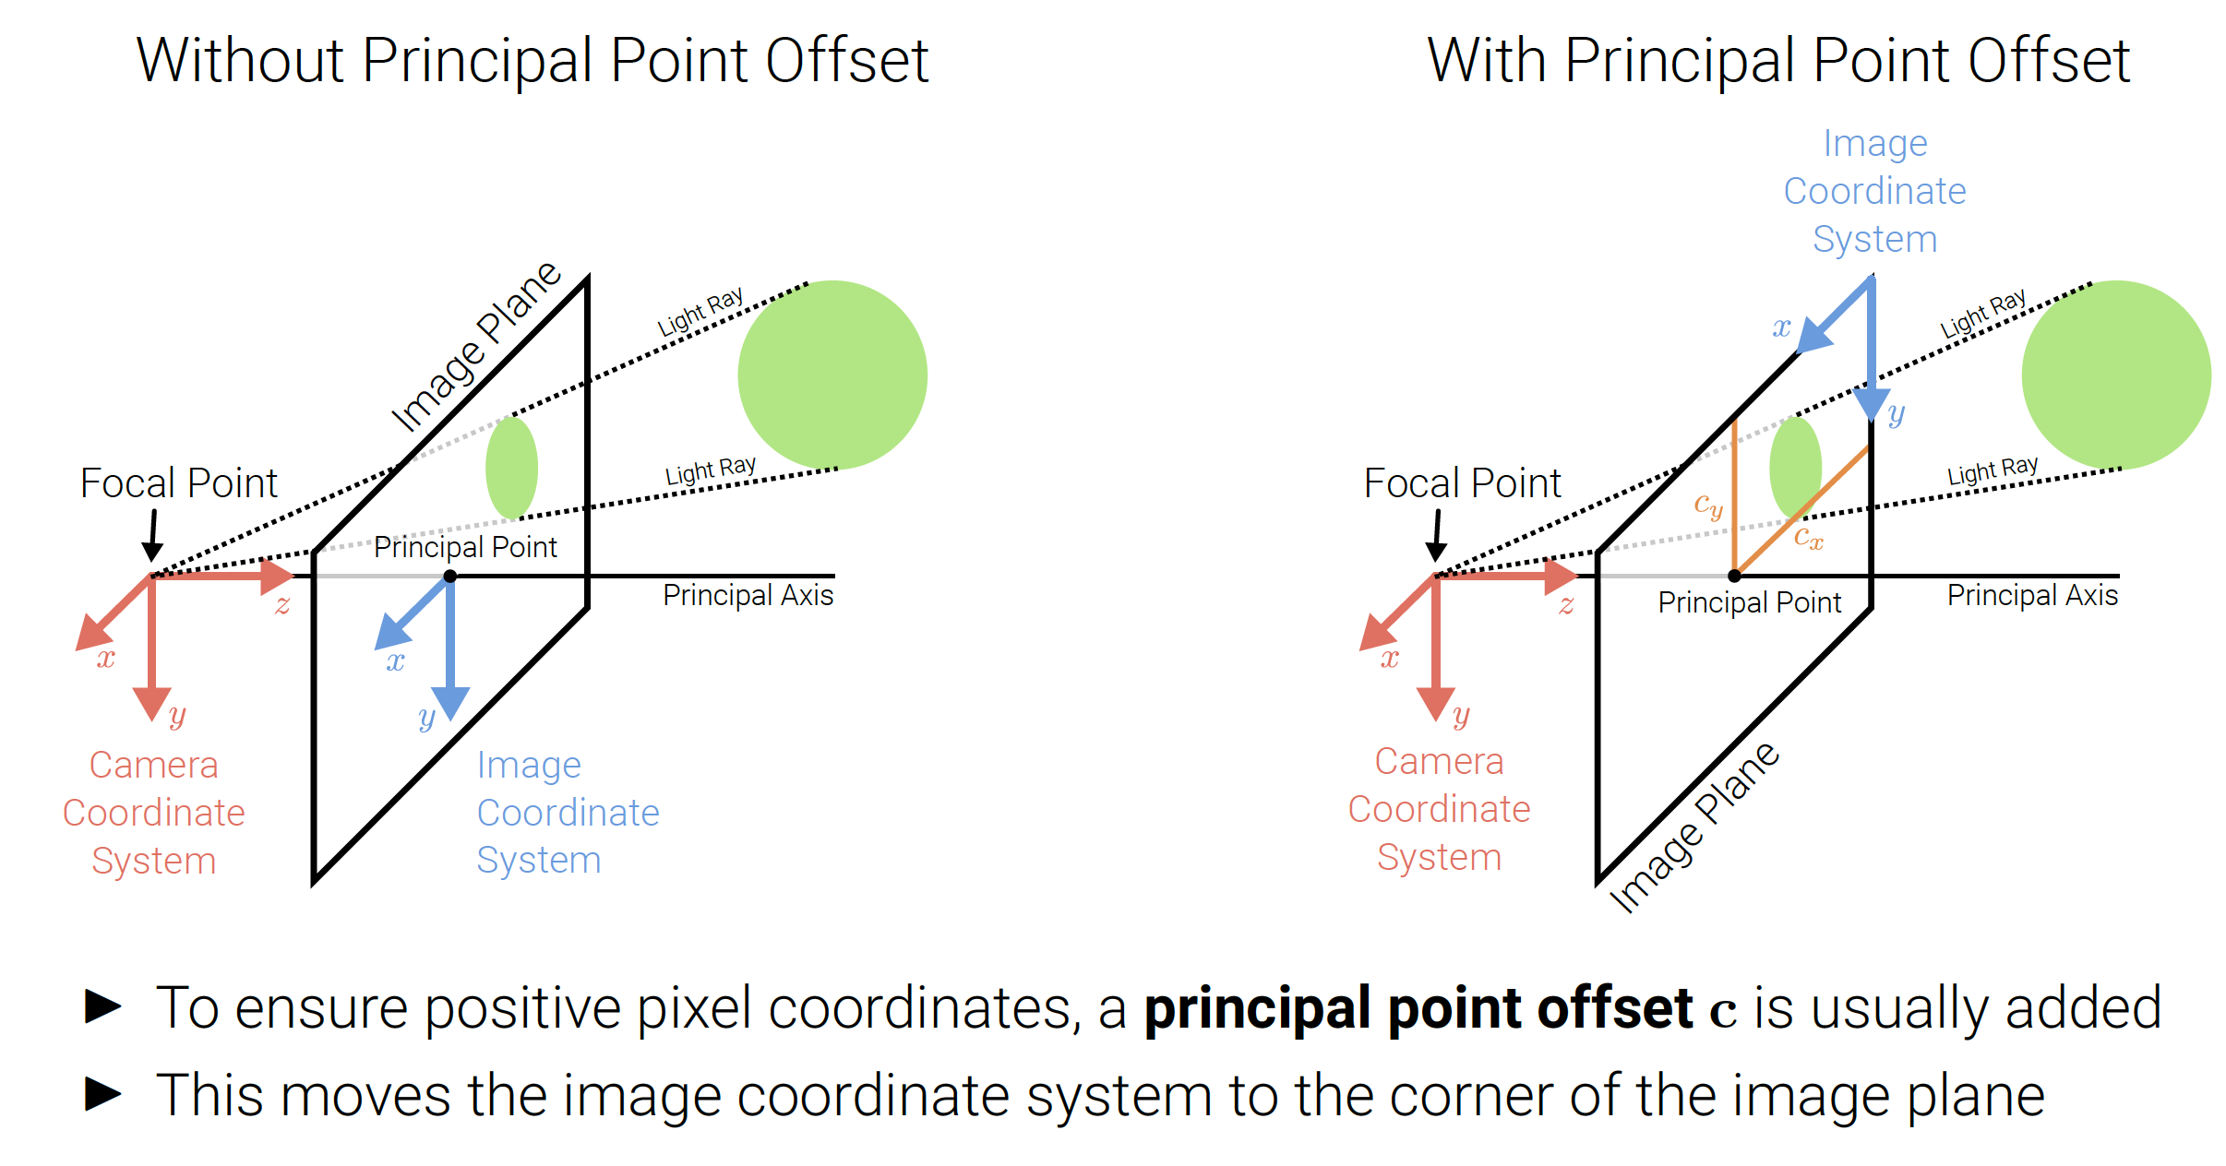
Perspective Projection

Slide 29
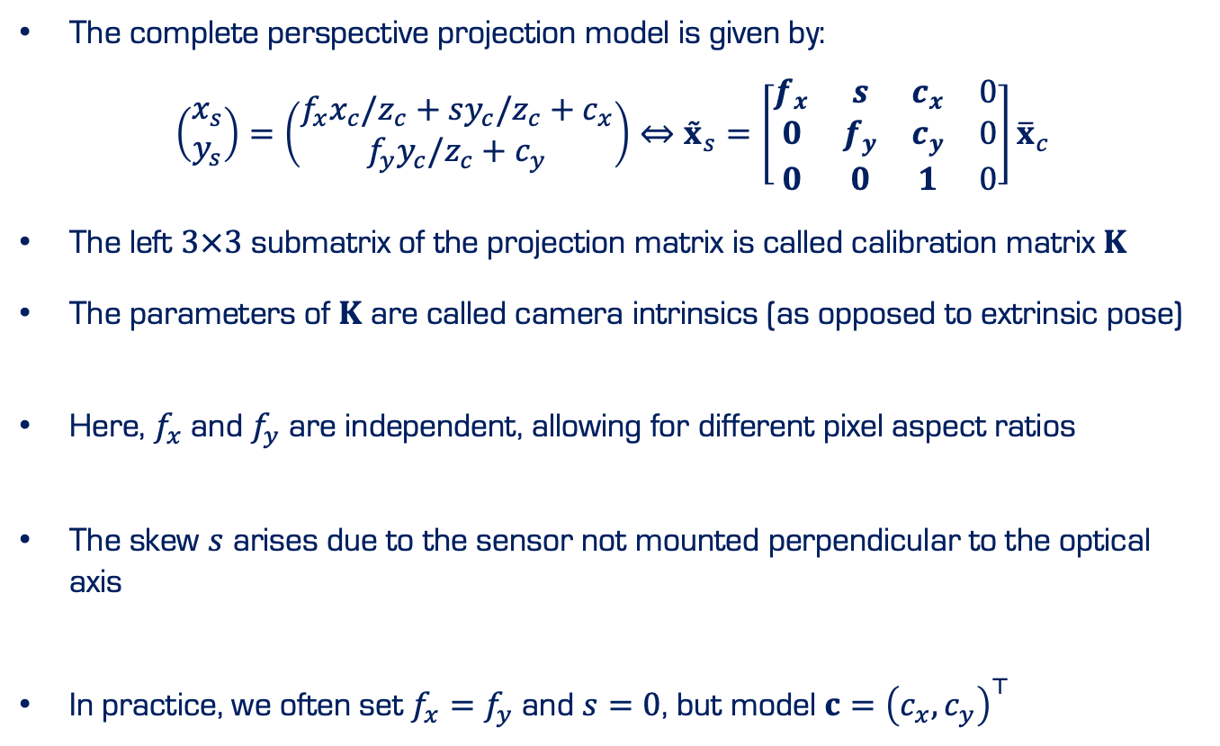
Perspective Projection
The complete perspective projection model is given by:
$$\left(\begin{matrix}x_{s} \\ y_{s}\end{matrix}\right)=\left(\begin{matrix}f_{x}x_{c}/z_{c}+sy_{c}/z_{c}+c_{x} \\ f_{y}y_{c}/z_{c}+c_{y}\end{matrix}\right)⇔{\overset{˜}{x}}_{s}=\left[\begin{matrix}f_{x} & s & c_{x} & 0 \\ 0 & f_{y} & c_{y} & 0 \\ 0 & 0 & 1 & 0\end{matrix}\right]{\overline{x}}_{c}$$
The left $3×3$ submatrix of the projection matrix is called calibration matrix $K$
The parameters of $K$ are called camera intrinsics (as opposed to extrinsic pose)
Here, $f_{x}$ and $f_{y}$ are independent, allowing for different pixel aspect ratios
The skew $s$ arises due to the sensor not mounted perpendicular to the optical axis
In practice, we often set $f_{x}=f_{y}$ and $s=0$, but model $c={\left(c_{x},c_{y}\right)}^{⊤}$

Slide 30
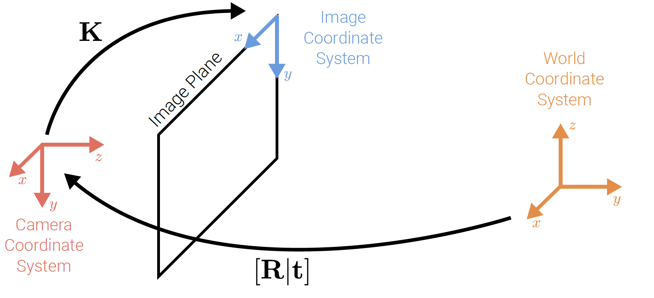
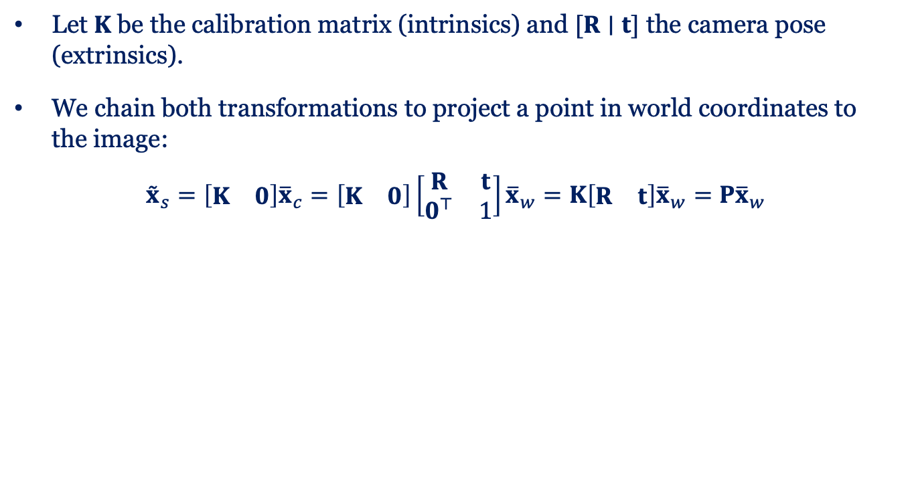
Chaining Transformation
Let $K$ be the calibration matrix (intrinsics) and $[R∣t]$ the camera pose (extrinsics).
We chain both transformations to project a point in world coordinates to the image:
$${\overset{˜}{x}}_{s}=\left[\begin{matrix}K & 0\end{matrix}\right]{\overline{x}}_{c}=\left[\begin{matrix}K & 0\end{matrix}\right]\left[\begin{matrix}R & t \\ 0^{⊤} & 1\end{matrix}\right]{\overline{x}}_{w}=K\left[\begin{matrix}R & t\end{matrix}\right]{\overline{x}}_{w}=P{\overline{x}}_{w}$$

Slide 31
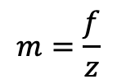

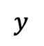
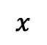
Perspective Projection
$$m=\frac{f}{z}$$
Image Magnification:
Image size inversely proportional to depth
f: Effective focal length
z
$$y$$
$$z$$
$$x$$

Slide 32
Perspective Projection
Vanishing point
$$y$$
$$z$$
$$x$$

Slide 33
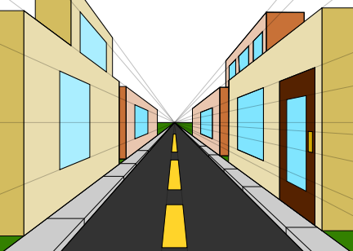

Perspective Projection
Vanishing point:
$$\left(x_{vp},y_{vp}\right)=\left(f\frac{l_{x}}{l_{z}},f\frac{l_{y}}{l_{z}}\right)$$
https://commons.wikimedia.org/wiki/File:1_point_perspective.svg

Slide 34
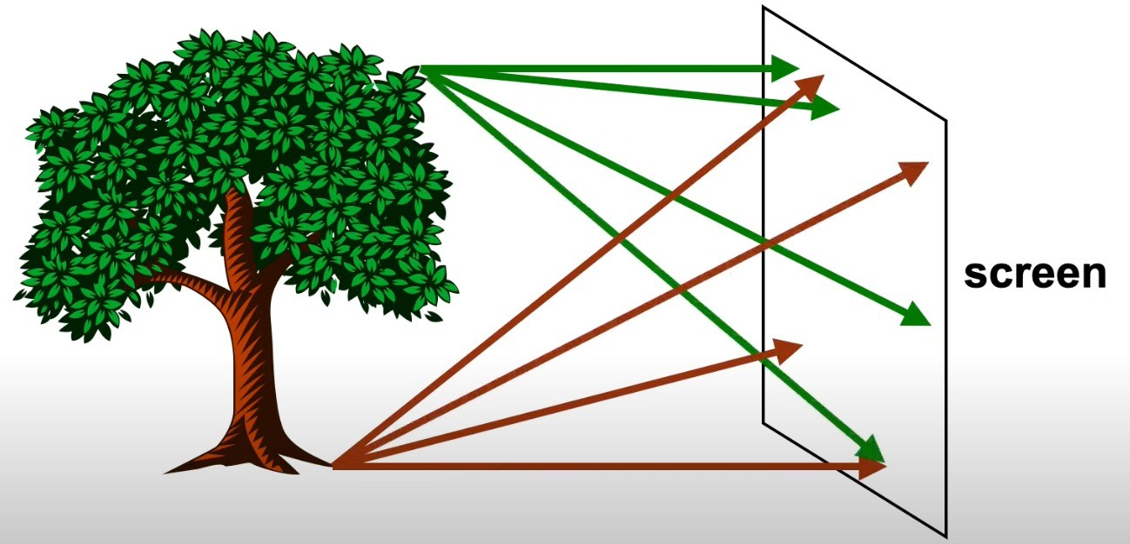
Perspective projection
Steve Seitz (https://g5m.cs.washington.edu/)

Slide 35
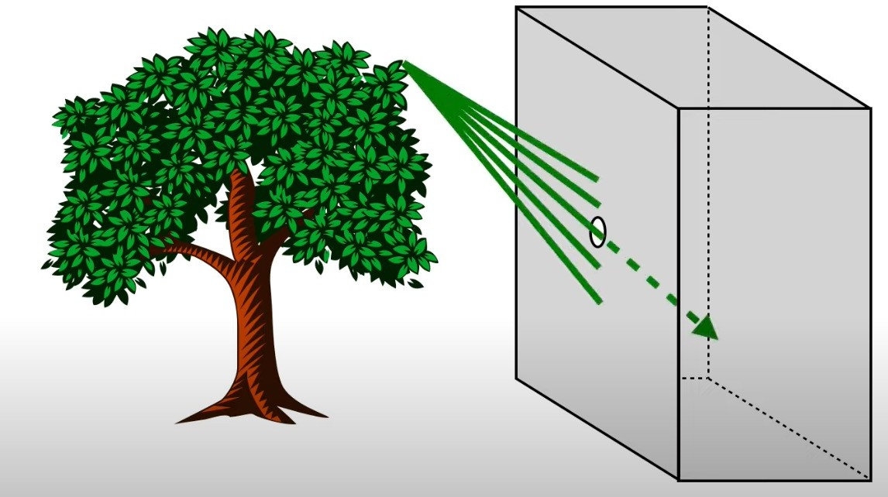
Perspective projection
Steve Seitz (https://g5m.cs.washington.edu/)

Slide 36

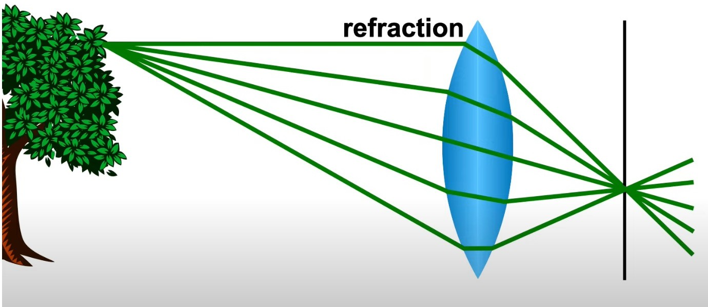
Perspective projection
The point is in focus
Lens
Image plane (film, sensor)
Steve Seitz (https://g5m.cs.washington.edu/)

Slide 37
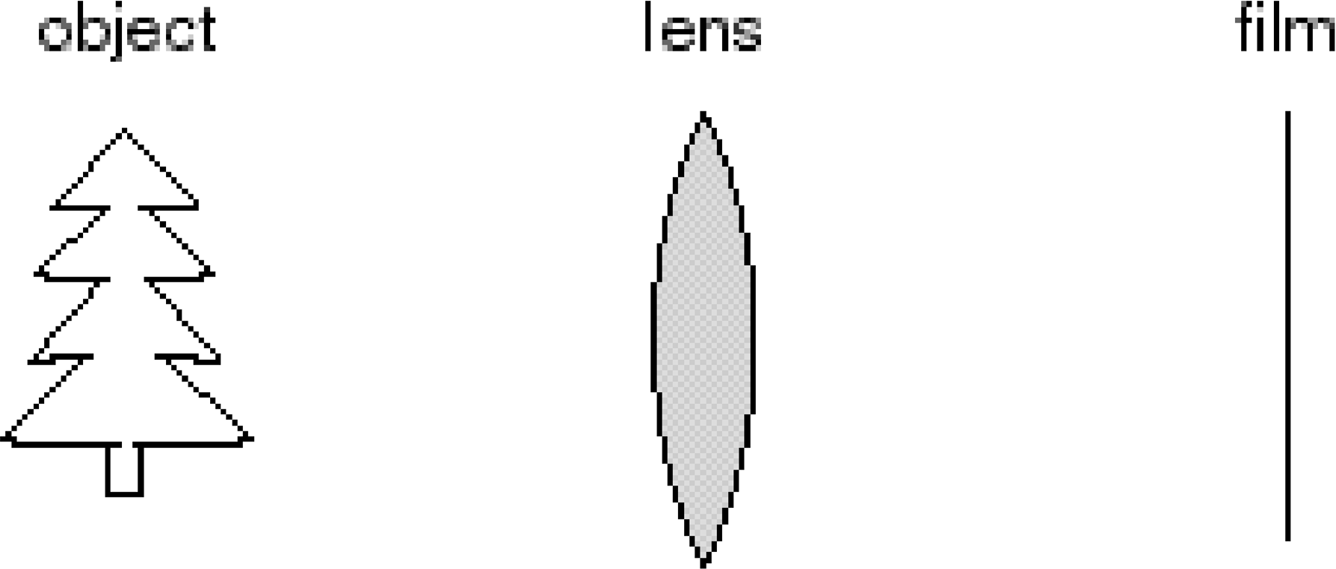
Adding a lens
“circle of confusion”
A lens focuses light onto the film
There is a specific distance at which objects are “in focus”
– other points project to a “circle of confusion” in the image
Changing the shape of the lens changes this distance
Source: Richard Szeliski: https://courses.cs.washington.edu/courses/

Slide 38
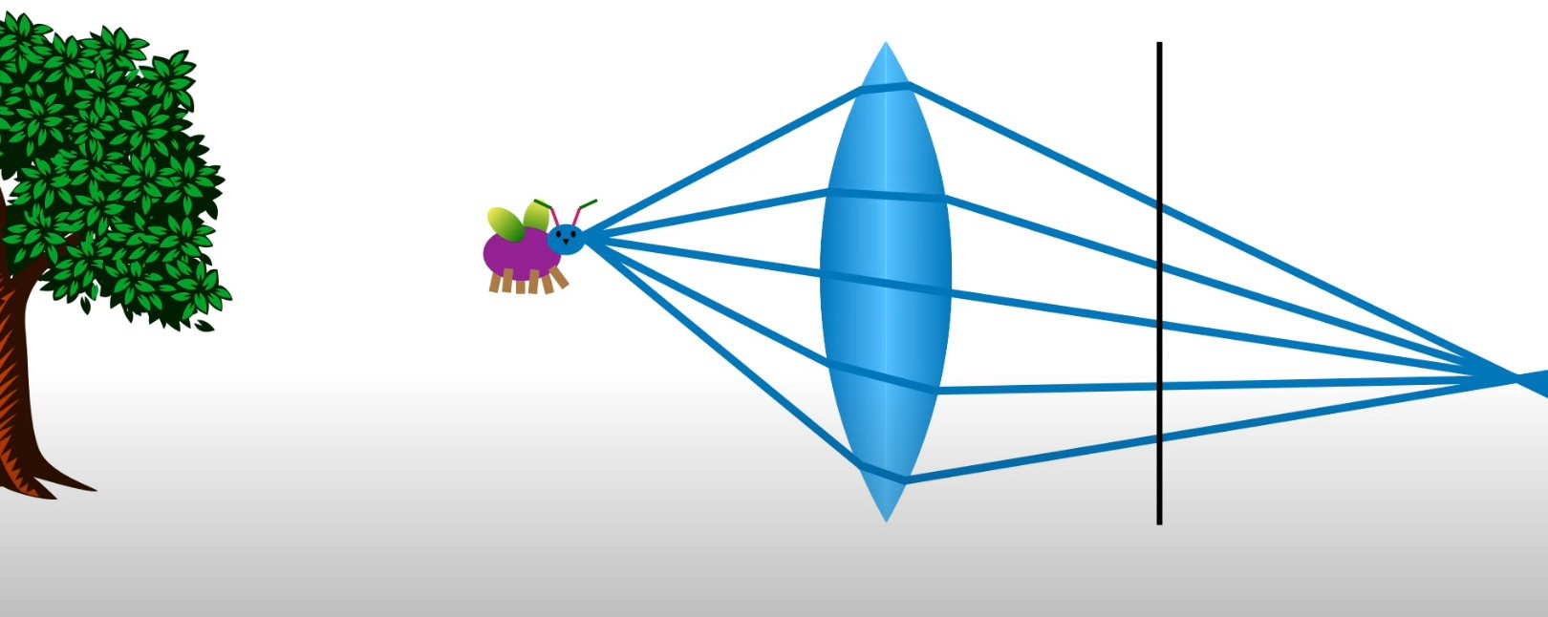
Perspective projection
Steve Seitz (https://g5m.cs.washington.edu/)

Slide 39
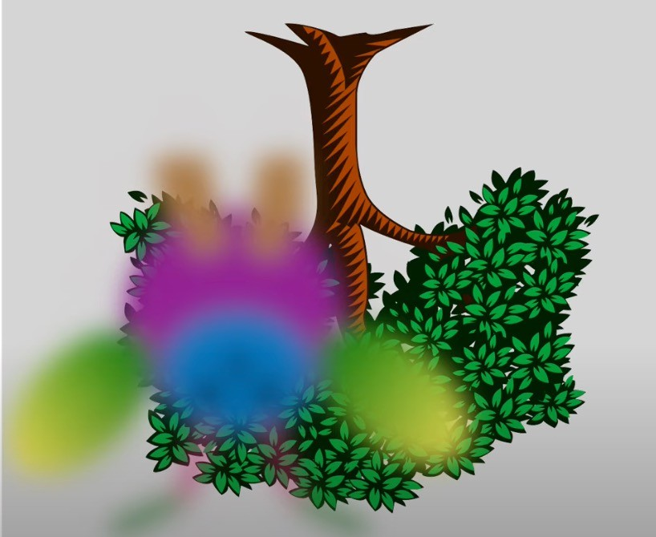
Perspective projection
Steve Seitz (https://g5m.cs.washington.edu/)

Slide 40
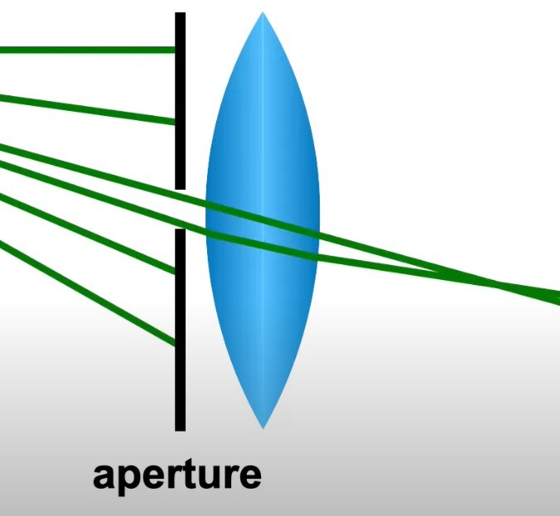
Perspective projection
Depth of field (DOF):
Refers to the range of distances within a scene that appears acceptably sharp in a photograph. In other words, it's the area in front of and behind the main subject that is in focus.
Steve Seitz (https://g5m.cs.washington.edu/)

Slide 41

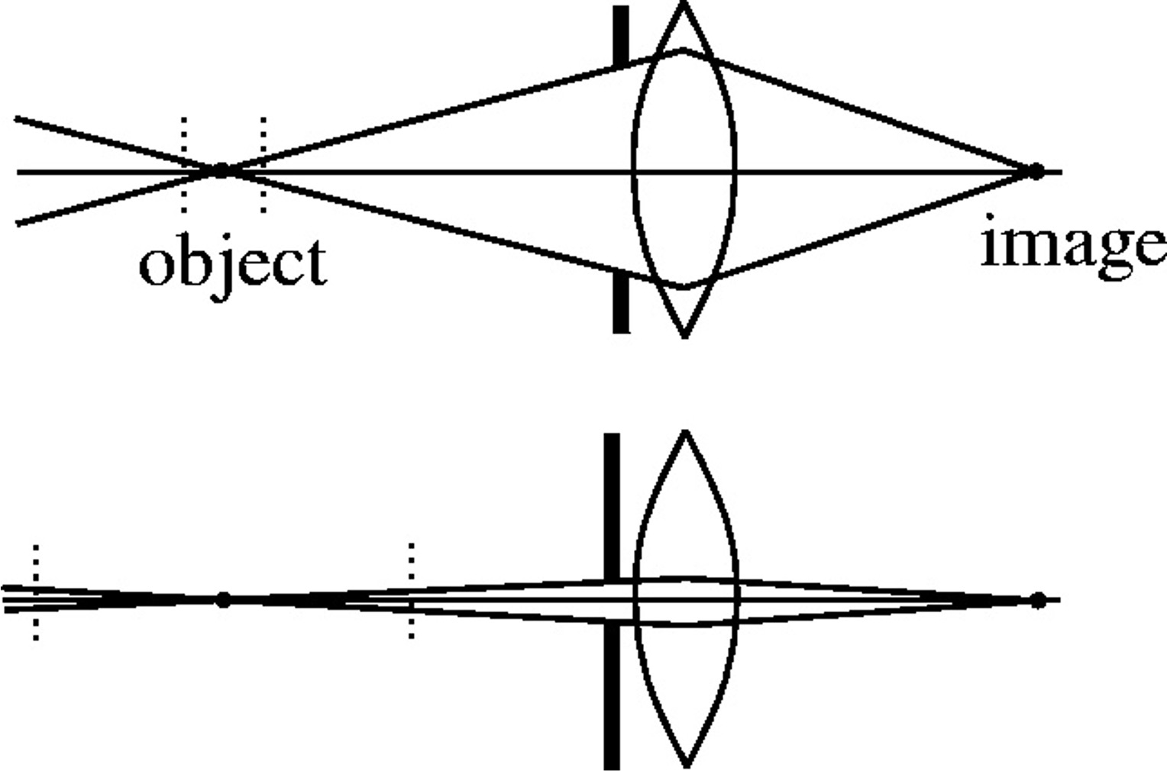

Depth of field
f / 5.6
f / 32
Changing the aperture size affects depth of field
A smaller aperture increases the range in which the object is approximately in focus
Source: Richard Szeliski: https://courses.cs.washington.edu/courses/

Slide 42

Perspective projection
Depth of field (DOF):
Closer object appear larger
Steve Seitz (https://g5m.cs.washington.edu/)

Slide 43
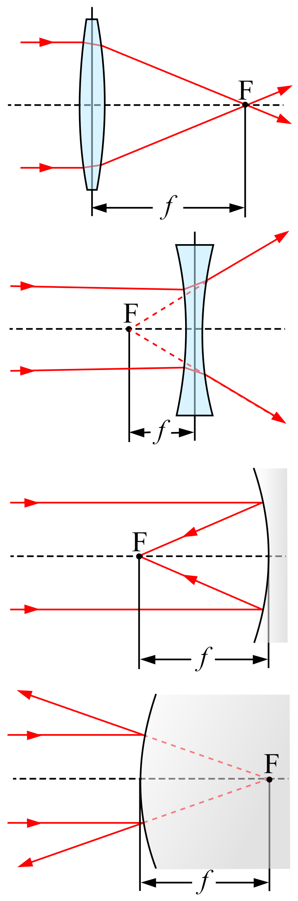
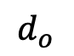
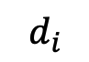
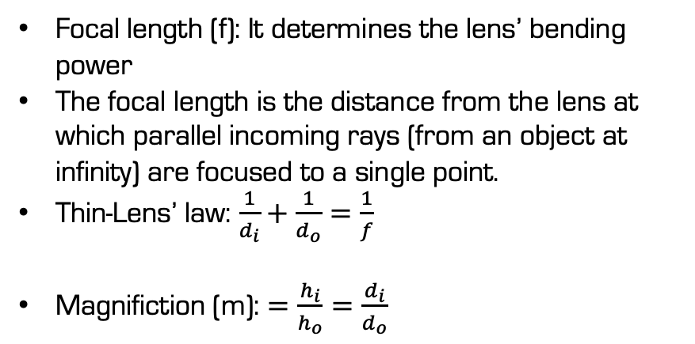
Lens
$$d_{o}$$
f
$$d_{i}$$
Focal length (f): It determines the lens’ bending power
The focal length is the distance from the lens at which parallel incoming rays (from an object at infinity) are focused to a single point.
Thin-Lens’ law: $\frac{1}{d_{i}}+\frac{1}{d_{o}}=\frac{1}{f}$
Magnifiction (m): $=\frac{h_{i}}{h_{o}}=\frac{d_{i}}{d_{o}}$
https://en.wikipedia.org/wiki/Focal_length

Slide 44
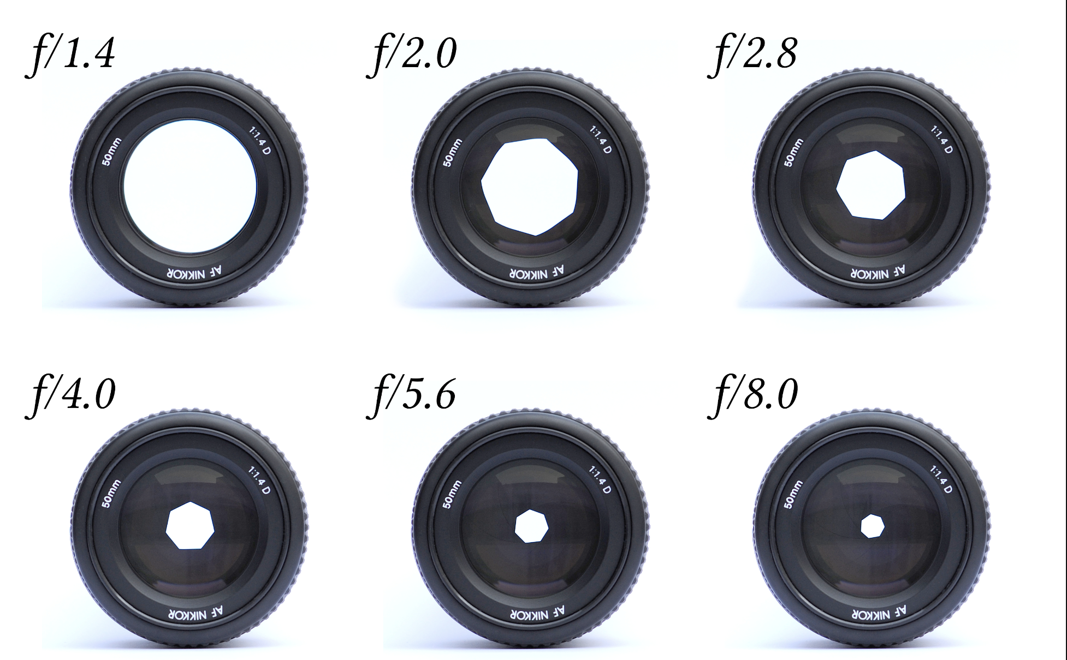
Lens
Aperture: Area of the lens receiving light

Slide 45

Lens
Aperture: Area of the lens receiving light
f-number: a measure of the light-gathering ability of a camera lens
it equals focal length divided by the aperture.
Aperture: $=\frac{f}{f−Number}$

Slide 46
Lens Defocus
Aperture
Image Plane
How to find the blur circle

Slide 47
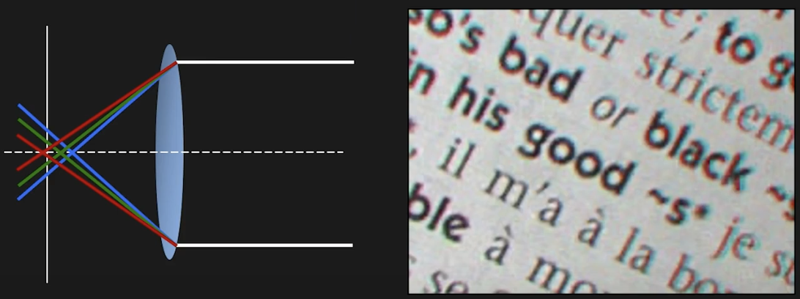
Lens Distortion
Chromatic Aberration
Refractive index (and hence focal length) of lens is different for different wavelengths.

Slide 48
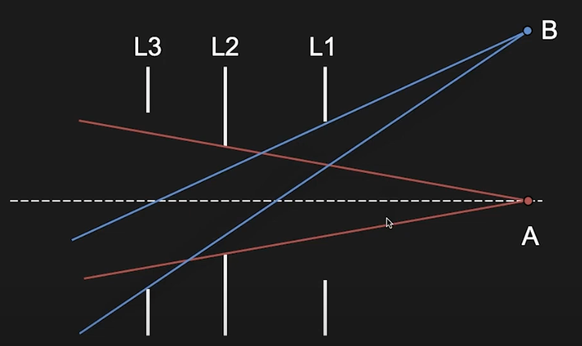

Lens Distortion
Vignetting

Slide 49
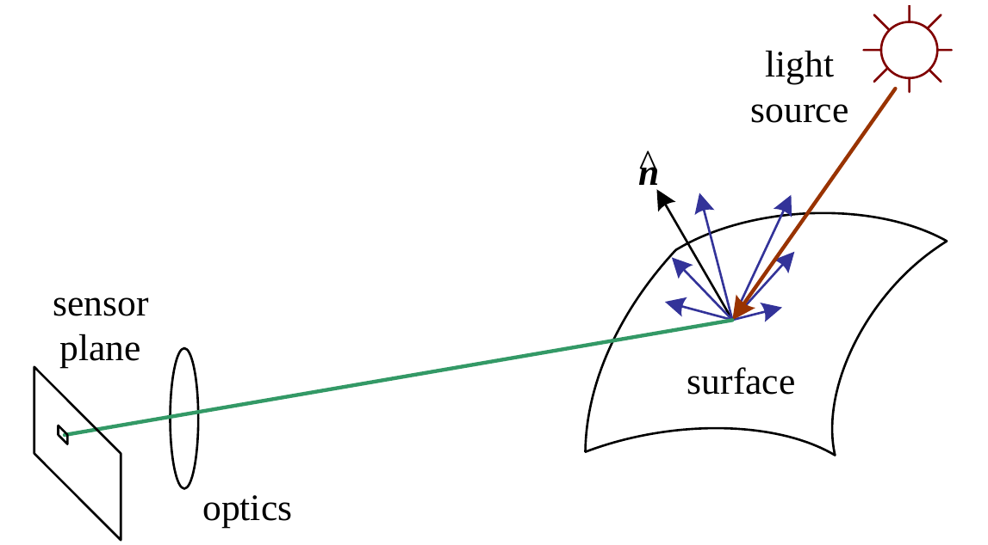
Photometric Image Formation
How an image is formed in terms of pixel intensities and colors.
Light is emitted by one or more light sources and reflected or refracted (once or multiple times) at surfaces of objects (or media) in the scene

Slide 50

Rendering Equation
Let $p∈ℝ^{3}$ denote a 3D surface point, $v∈ℝ^{3}$ the viewing direction and $s∈ℝ^{3}$ the incoming light direction.
The rendering equation describes how much of the light $L_{\text{in} }$ with wavelength $λ$ arriving at $p$ is reflected into the viewing direction $v$ :
$$L_{\text{out} }(p,v,λ)=L_{\text{emit} }(p,v,λ)+\int_{Ω}{ }BRDF⁡(p,s,v,λ)⋅L_{\text{in} }(p,s,λ)⋅\left(−n^{⊤}s\right)ds$$
$Ω$ is the unit hemisphere at normal $n$
The bidirectional reflectance distribution function $BRDF⁡(p,s,v,λ)$ defines how light is reflected at an opaque surface.
$L_{\text{emit} }>0$ only for light emitting surfaces

Slide 51


Global Illumination
Modeling one light bounce is insufficient for rendering complex scenes
Light sources can be shadowed by occluders and rays can bounce multiple times
Global illumination techniques also take indirect illumination into account

Slide 52

Diffuse and Specular Reflection

Slide 53

Image Sensor
Physical light transport in the camera lens/body
Photon measurement and conversion on the sensor chip
Image signal processing (ISP) and image compression
Notes:
Scene Radiance
Light emitted or reflected by the scene, continuous in space, time, and wavelength.
Optics
Projects the 3D scene onto the 2D sensor plane, determining field of view, scale, and optical blur.
Aperture
Controls the amount of light entering the camera and the depth of field.
Shutter
Controls exposure time, trading off motion blur against noise.
Sensor (CCD/CMOS)
A discrete grid of photodiodes that converts incoming photons into electrical charge.
Gain (ISO)
Amplifies the sensor signal to adjust brightness, increasing noise along with signal.
ADC (Analog-to-Digital Converter)
Quantizes the analog sensor voltages into digital pixel values.
RAW
Minimally processed sensor data preserving maximum dynamic range and information.
Demosaic
Reconstructs full RGB values at each pixel from the color filter array measurements.
Denoise and Sharpen
Reduces sensor noise and compensates for optical and sampling blur.
White Balance
Corrects color biases caused by different illumination spectra.
Gamma / Curve
Applies a nonlinear tone mapping to match human perception and display characteristics.
Compress
Reduces file size by removing perceptually redundant information.
JPEG
A compact, viewable image format optimized for storage and display, with information loss.

Slide 54

Image Sensor
CCDs move charge from pixel to pixel and convert it to voltage at the output node
CMOS images convert charge to voltage inside each pixel and are standard
https://meroli.web.cern.ch/lecture_cmos_vs_ccd_pixel_sensor.html

Slide 55


Image Sensor
Color Filter:
To measure color, pixels are arranged in a color array, e.g.: Bayer RGB pattern
I Missing colors at each pixel are interpolated from the neighbors (demosaicing)

Slide 56



Image Sensor
Color Filter:
To measure color, pixels are arranged in a color array, e.g.: Bayer RGB pattern
Missing colors at each pixel are interpolated from the neighbors (demosaicing)

Slide 57

Sampling and Quantization in Digital Imaging
The Continuous Image Model
Scene projected onto the image plane is a continuous function
$$f(x,y), (x,y)∈ℝ^{2}$$
Infinite spatial resolution
Infinite intensity precision
This image cannot be stored by a digital system.

Slide 58

Sampling and Quantization in Digital Imaging
From Continuous to Digital:
$$f(x,y)\overset{ \text{sampling} }{→}f[m,n]\overset{ \text{quantization} }{→}\overset{ˆ}{f}[m,n]$$
Sampling → discretizes space
Quantization → discretizes intensity

Slide 59

Pixel Pitch and Resolution
Pixel Pitch = Sampling Frequency
Pixel pitch = distance between pixel centers
Smaller pitch → higher sampling frequency
Sampling frequency:
$$f_{s}=\frac{1}{Δx}$$

Slide 60

Quantization
Intensity Quantization
Maps continuous intensity to discrete levels
For $b$ bits:
$$L=2^{b} \text{intensity} \text{levels}$$
Example:
8-bit → 256 levels
12-bit $→4096$ levels

Slide 61
Reference
https://uni-tuebingen.de/fakultaeten/mathematisch-naturwissenschaftliche-fakultaet/fachbereiche/informatik/lehrstuehle/autonomous-vision/lectures/computer-vision/

